Slide 1
Evaluation of NFL Receivers with Markov Chains & K-Means Clustering
Ryker Moreau | Elijah Cavan

Slide 2
Overview
Markov Model
K-means Clustering
NFL Application
Background
Markov Chains for play states
K-Mean Clustering by target probability
Results

Slide 3
Markov Model
A stochastic method for randomly changing systems, with probability associated with a sequence of events occurring based on a previous state
It is assumed that future states do not depend on past states
It aims to show:
All possible states
Transitions between states
Rate/Probability of transitions
Types of Markov Models:
Markov Chain
Hidden Markov Model
Markov Decision processes
Partially observed Markov Decision processes

Slide 4
Markov Chain
A process which has memoryless characteristics
A process X(t) =X₀, X₁, X₂, … is a Markov Chain if it satisfies the Markov property:
P(X_{n+1}= s | X₀= x₀, X₁= x₁, X₂= x₂, … , X_{n}= x_{n}) = P(X_{n+1}= s | X_{n}= x_{n})
P(X_{n+1}= j | X_{n}= i) are called transition probabilities
Two main components
Transition Matrix
Initial State Vector

Slide 5
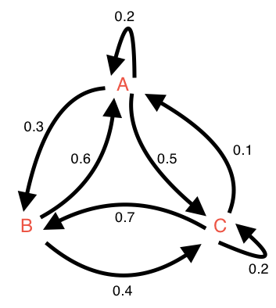
Transition Matrix
Transition Matrix (N x N) contains the probability distribution of each state’s transitions
Type of stochastic matrix, since row sums will be equal to 1
For example: If you are in state A, the probability of transitioning to each of the other states is
P(X_{n+1}= A | X_{n}= A) = 0.2
P(X_{n+1}= B | X_{n}= A) = 0.3
P(X_{n+1}= C | X_{n}= A) = 0.5

Slide 6
Initial State Vector
Not only do we need to transition states, we need a starting point
Initial State Vector is a vector (N x 1) which contains the probability distribution of starting at each of the N possible states
The initial state of the Markov Chain is determined by
Taking product of transition matrix, P, and identity matrix (P x I)
Probability of future events is then determined by
Raising transition matrix, P, to the m-th power (P^{m})

Slide 7
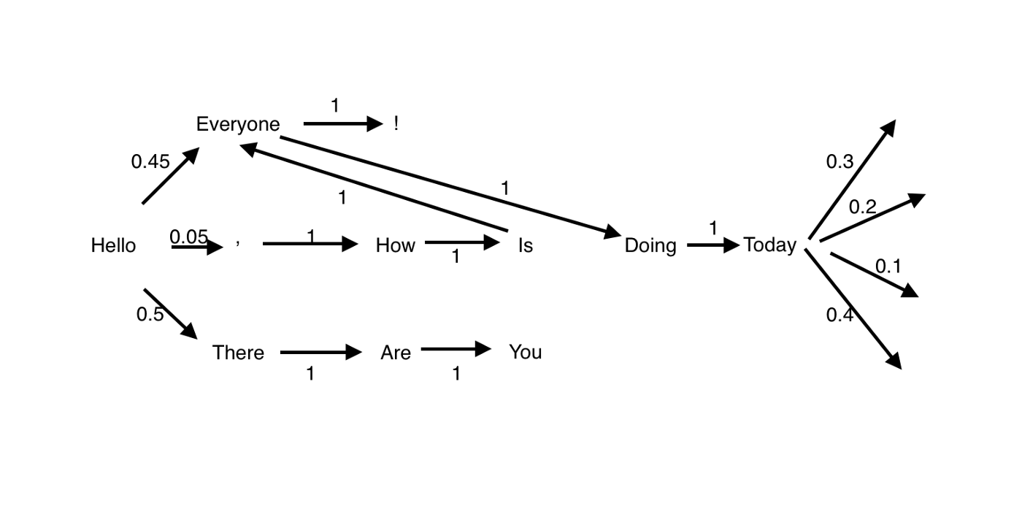
Simple Markov Chain Example

Slide 8
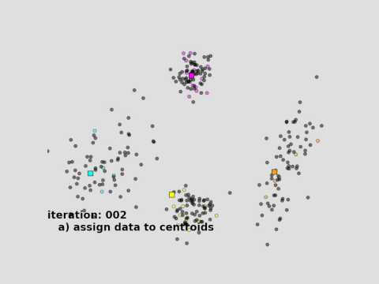
K-Means Clustering

Slide 9
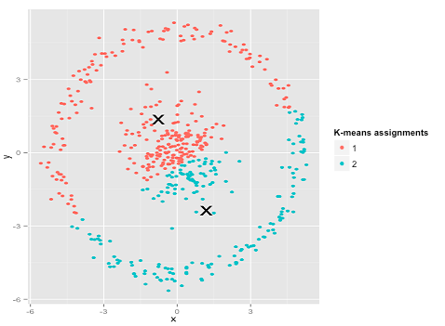
Shortcomings
Advantages
Simple algorithm practically guarantees convergence
Scales well with large data sets
Generalizes well to clusters of different shapes (that are spherical)
Computationally efficient
Assumes the variance of each variable is spherically distributed
Assumes all variables have the same variance
the prior probability for all k clusters are the same (i.e doesn’t work great if there are an unequal number of points in each cluster)
Required to choose k, a priori
Doesn’t scale well with the curse of dimensionality (large number of features)

Slide 10
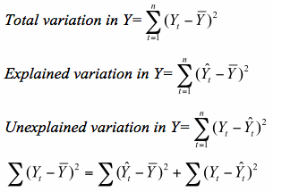
Evaluation of Results
A tradeoff between minimizing the total variance of the data which can be decomposed into the WCSS (within-cluster sum of squares) or unexplained variance and the BCSS or explained variance
A.K.A The Law of Total Variance

Slide 11
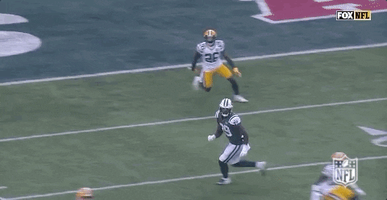
Application to the National Football League

Slide 12
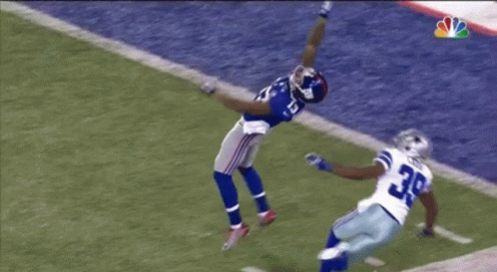
Application Overview
The National Football League is comprised of 32 teams with approximately 50 active players on each team
We focus on the receivers, (WR, TE, and RB) and their contribution to an offensive drive
Data includes tracking data for every passing play from the 2018 season

Slide 13
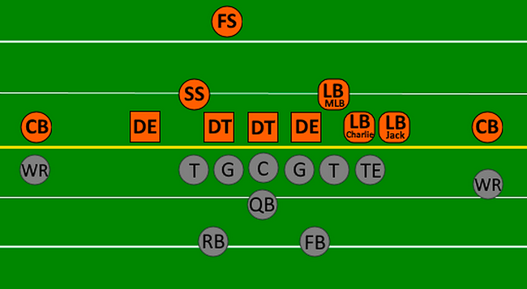
Recipe for Our Adaptation
Step 1:
Define States (Transient and Absorption)
The Markov Chain
Transition Matrix - Transient & Absorption
Fundamental Solution Matrix
Step 2:
Binning receiver targets
Clustering using adapted K-Means
Step 3:
Apples-to-Apples comparison of NFL players

Slide 14
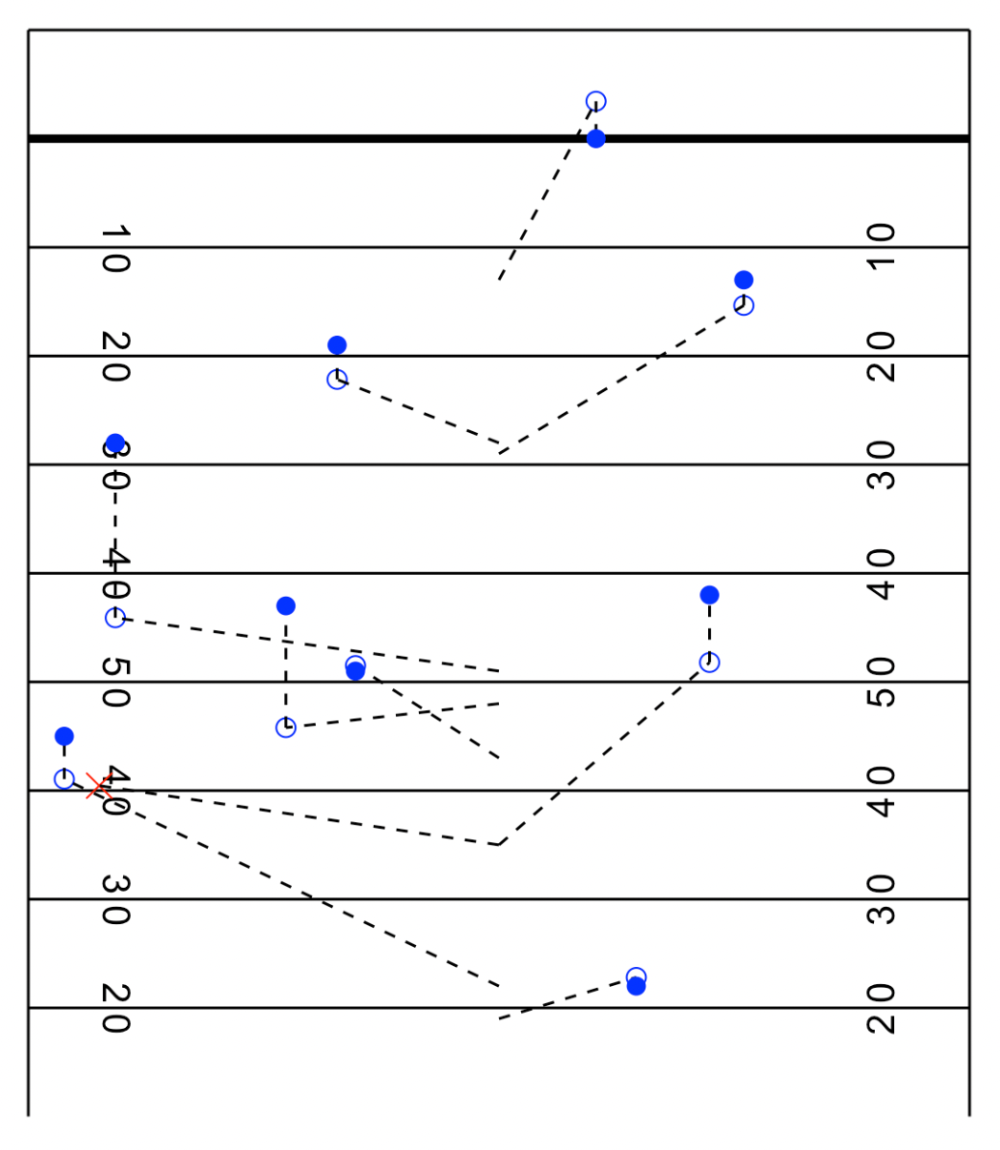
TD drive by the Kansas City Chiefs
9 completed passes
1 incomplete pass
Gaps in the drive are likely runs, sacks, or penalties

Slide 15
Markov Chain States
Transient States
Define these states by binning and combining “Down”, “Yards-to-go”, and “Field Location”
Example: 1st and short from the 41-60 yard line
Absorption States
States in which the drive ends
Possible absorption states: Touchdown (Passing and Rushing), Field Goal, or Drive End
Transition Matrix steps:
Create a transition matrix with all states
Split into :
n x n matrix, Q, containing only transient states
n x r matrix, R, containing only absorption states

Slide 16
Fundamental Solution Matrix
Once we have our transition matrices, we can produce our fundamental solution matrix
Let fundamental matrix, F = (I - Q)⁻¹
This matrix is used to produce results such as:
Expected number of plays in a drive from a transient state
Probability of absorption states from a transient state
Expected Points Added (EPA) of each pass based on next state

Slide 17
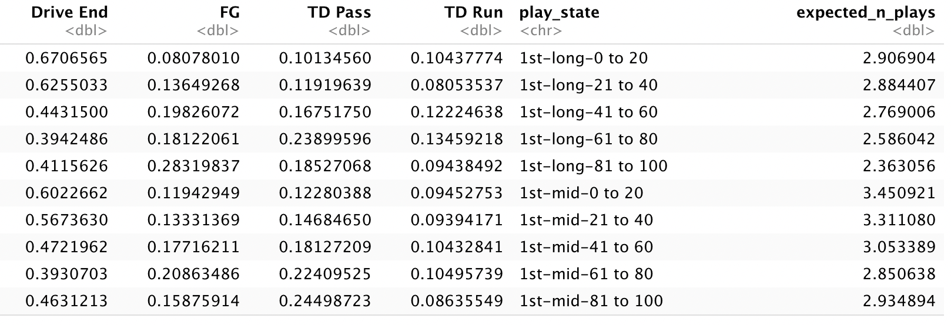
Markov Chain Results

Slide 18
Markov Chain Results
EPA(play_state = 1st-long-61 to 80) = 7*(0.24 + 0.13) + 3*(0.18) = 3.13

Slide 19
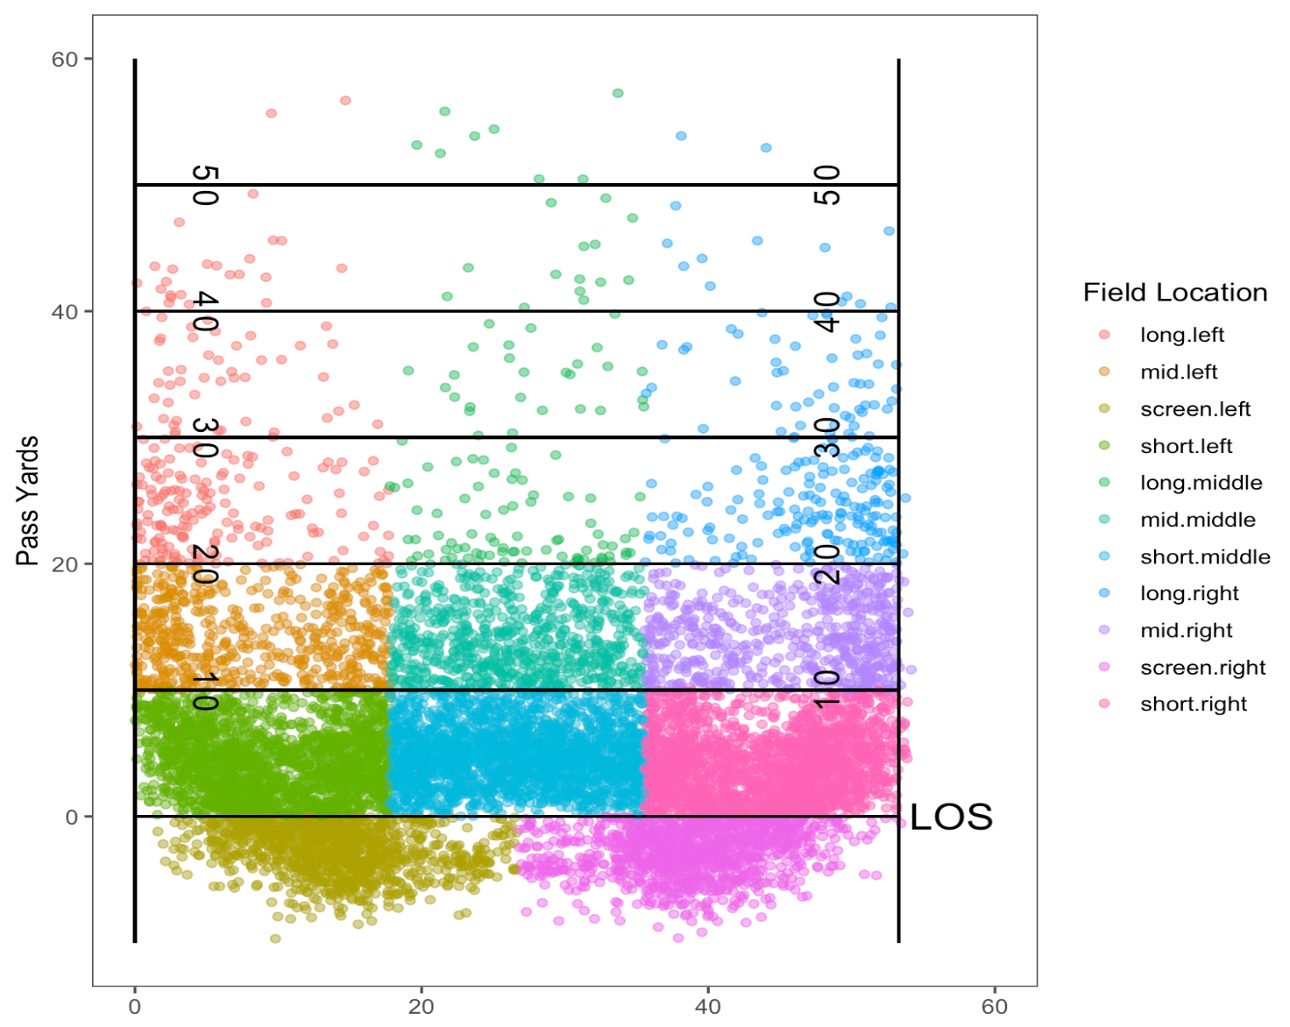
Binning Receiver Targets
All completions during the 2018 season, scaled to have the same starting point

Slide 20
Adapted K-Means
Our adapted K-Means Algorithm is depicted as followed:
Draw values of k randomly from Uniform(a,b)
Randomly assign points to clusters
Calculate the centroids, get the BCSS
Determine the optimal value of k from repeated sampling
Re-initialize the algorithm with the new value of k
After the algorithm has converged, recalculate a player’s affinity to each cluster and re-assign as needed

Slide 21
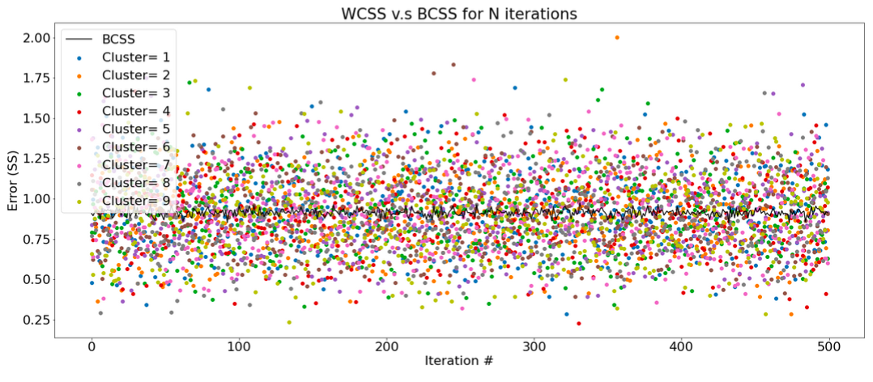
Simulation Results I

Slide 22
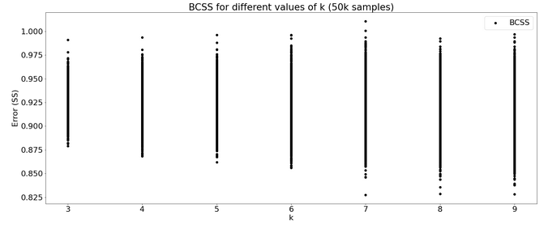
Simulation Results II
Optimal value of k

Slide 23
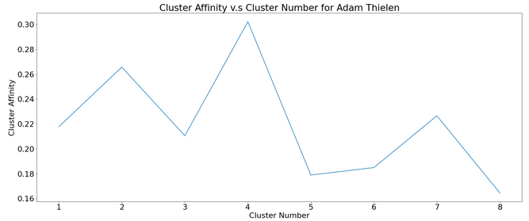
Simulation Results III
Assigned cluster
Highest Affinity cluster

Slide 24
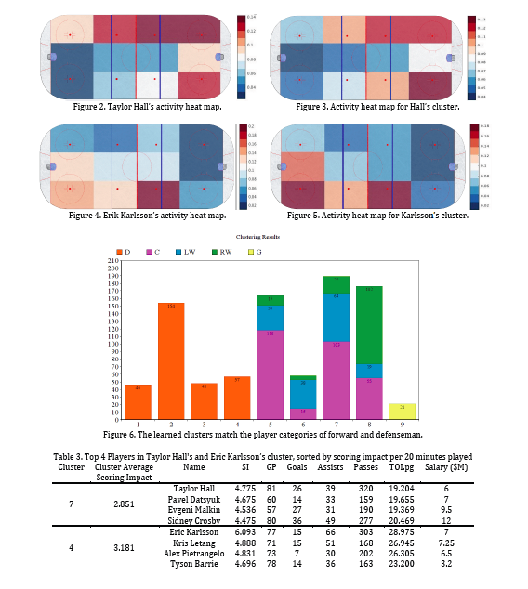
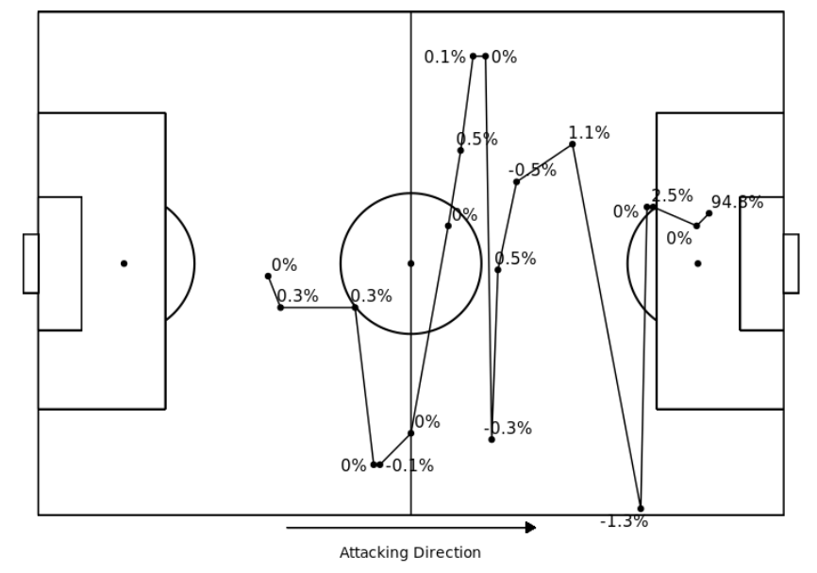
Apples-to-Apples Comparison
Our work reproduces results from Schulte et al. who compared players in the National Hockey League
They clustered players based on their actions on the ice, and then evaluated them using a Markov model
The affinity algorithm was used for clustering
Our Markov model was inspired by an article by statsbomb called ‘attacking contributions’ (researches non-shot expected goals models)

Slide 25
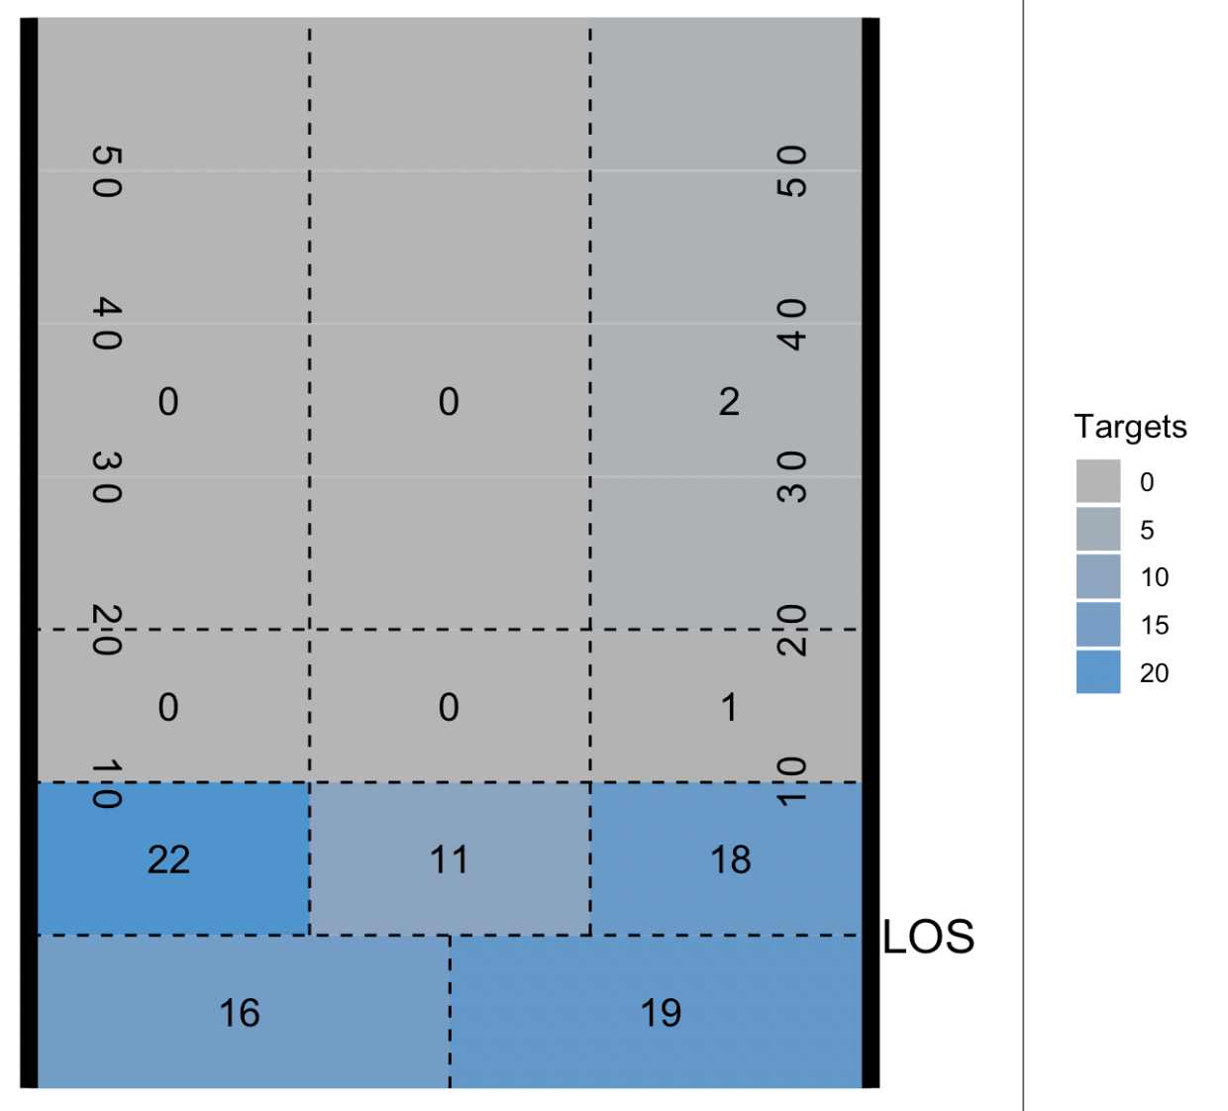
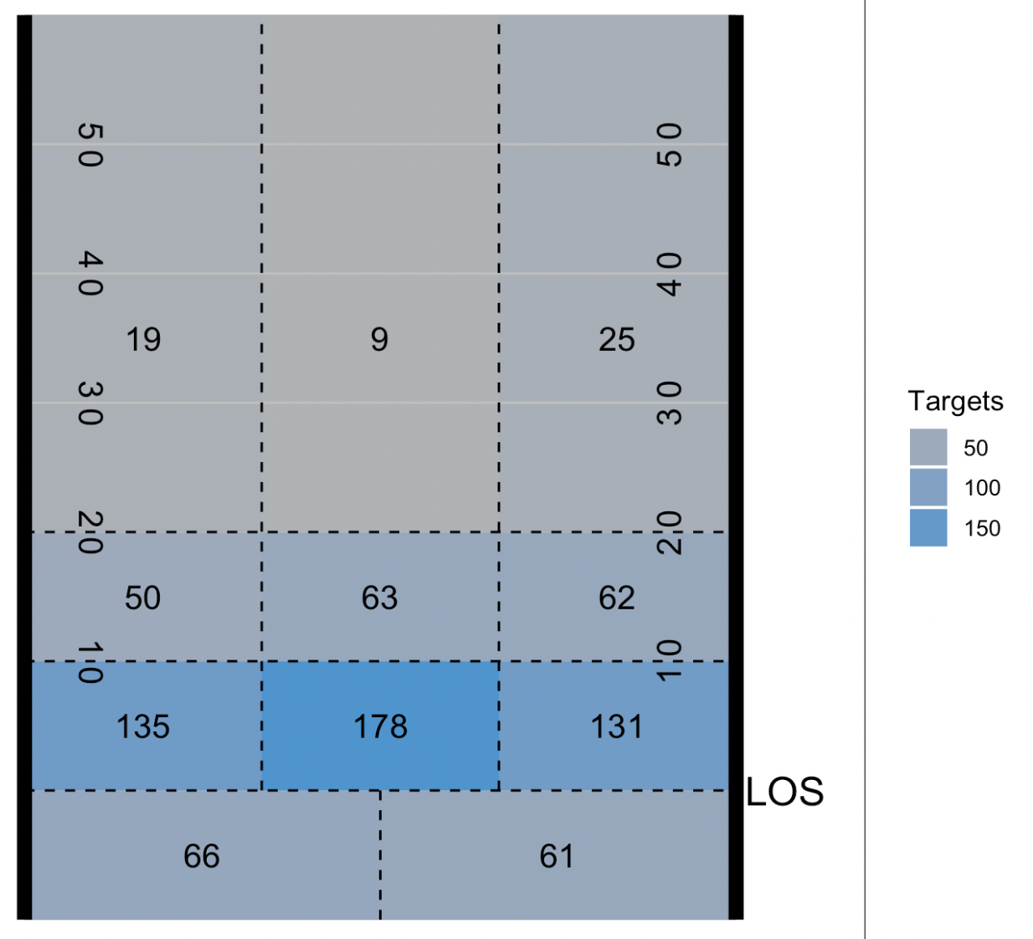
Results: Apples-to-Apples Comparison
Alvin Kamara’s Heatmap
Alvin Kamara’s Cluster Heatmap

Slide 26
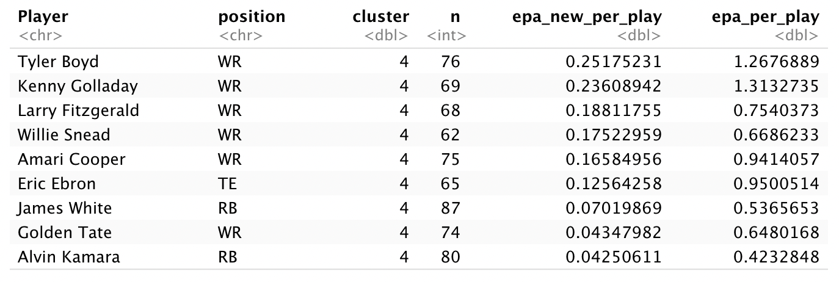
Cluster Results
Expected Points Added Per Play = EPA(new_state) - EPA(previous state)

Slide 27
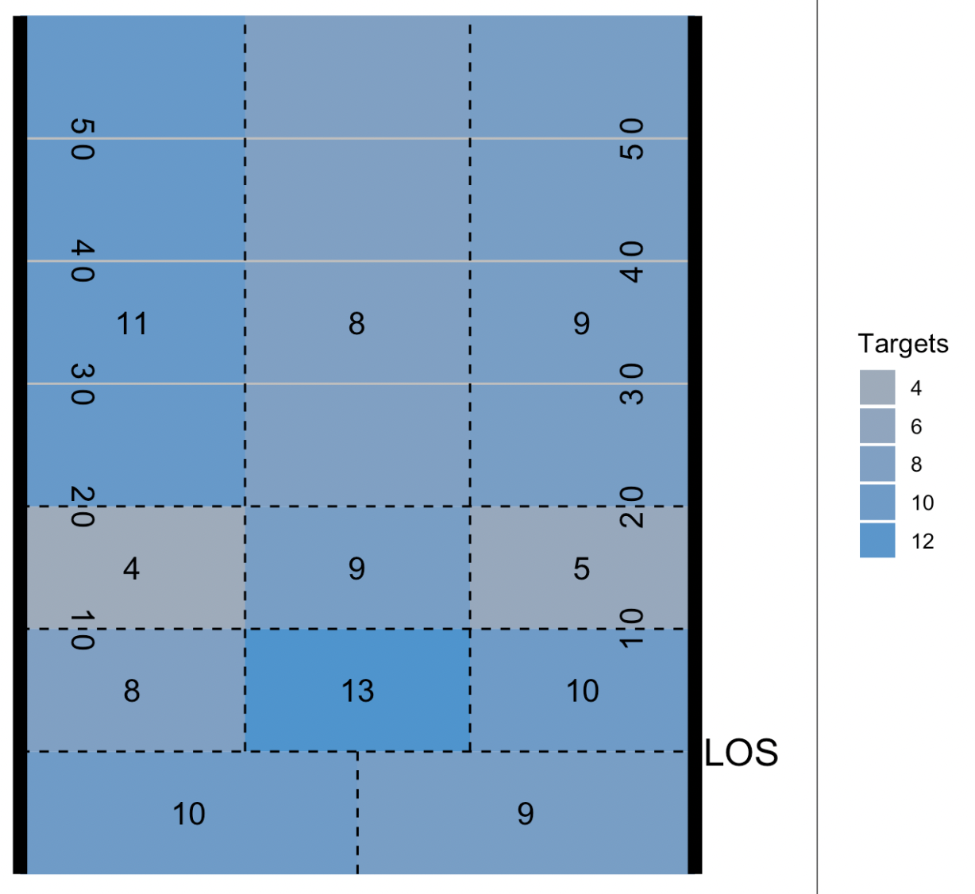
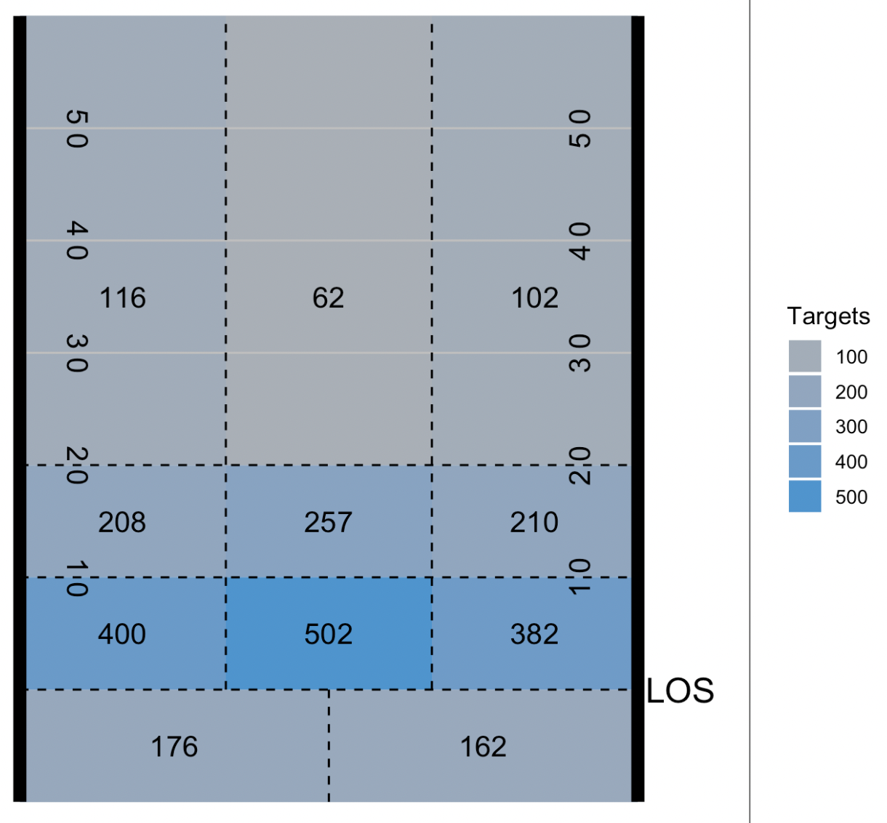
Results: Apples-to-Apples Comparison
Tyreek Hill’s Heatmap
Tyreek Hill’s Cluster Heatmap

Slide 28
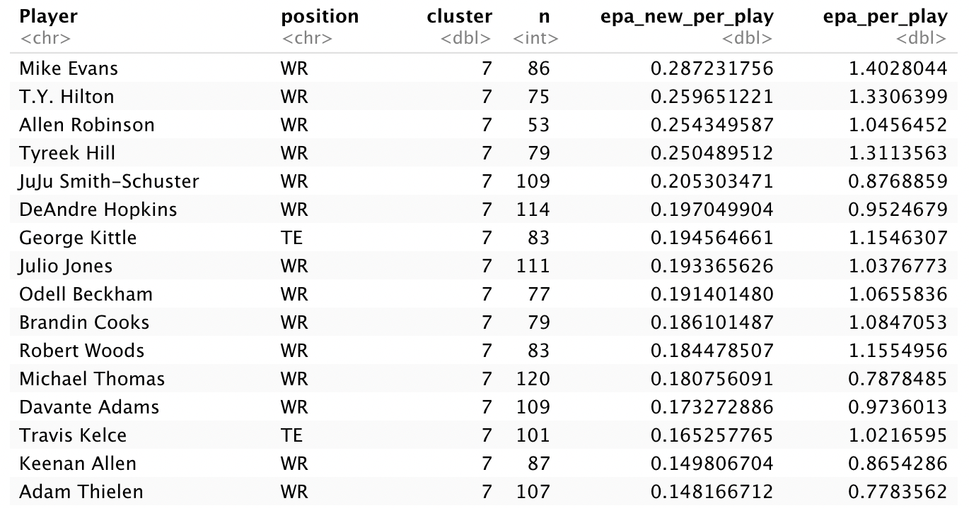
Cluster Results

Slide 29
Thank You!

